Slide 1
Ministry of Jal Shakti
Department of Water Resources, RD & GR
Water Information Management System (WIMS)
National Water Informatics Centre

Slide 2
Online WIMS Training Session
National Water Informatics Centre(NWIC)
Topic : Telemetry Management in WIMS. How to create/edit telemetry station, sensor/data type mapping and sensor configuration in WIMS?
Date of Training: 24/06/2021
Venue: Online Webinar
Organised By : NWIC,NHP, NPMU
.

Slide 3
Welcome
.

Slide 4
Water Information Management System (WIMS)
National Water Informatics Centre(NWIC)
Contact Details :
Trainer Name : Meet Kumar Agarwal
Department : National Water Informatics Centre(NWIC) Email Id :helpdesk-nwic@gov.in Contact No : 9650866776

Slide 5
Training Topics (For Surface Water/Ground Water)
Telemetry Management in WIMS
How to transmit telemetric data in WIMS
Add /Edit Telemetric Station for Surface Water and Ground Water station types
Data Type/Sensors Mapping for SW and GW station types for telemetric stations
How to configure the sensors on telemetry sites in WIMS ?
In Sensor Hub Configuration (SW /GW i) Create Data Logger Configuration ii) Add Sensor Configuration iii) Edit Sensor Configuration
How to delete the sensors from data logger id in WIMS?
How to monitor, view , verify & download telemetric data by using data view or data view management in WIMS?
Questions and Answers with Feedback

Slide 6
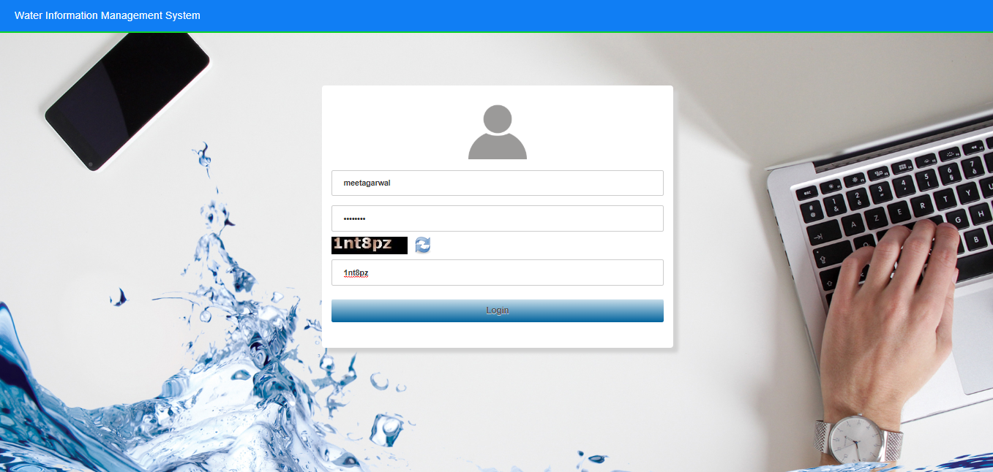
Login into WIMS (Water Information Management System) Enter Login, Password & Captcha details based on the User Agency. Click on Login button

Slide 7
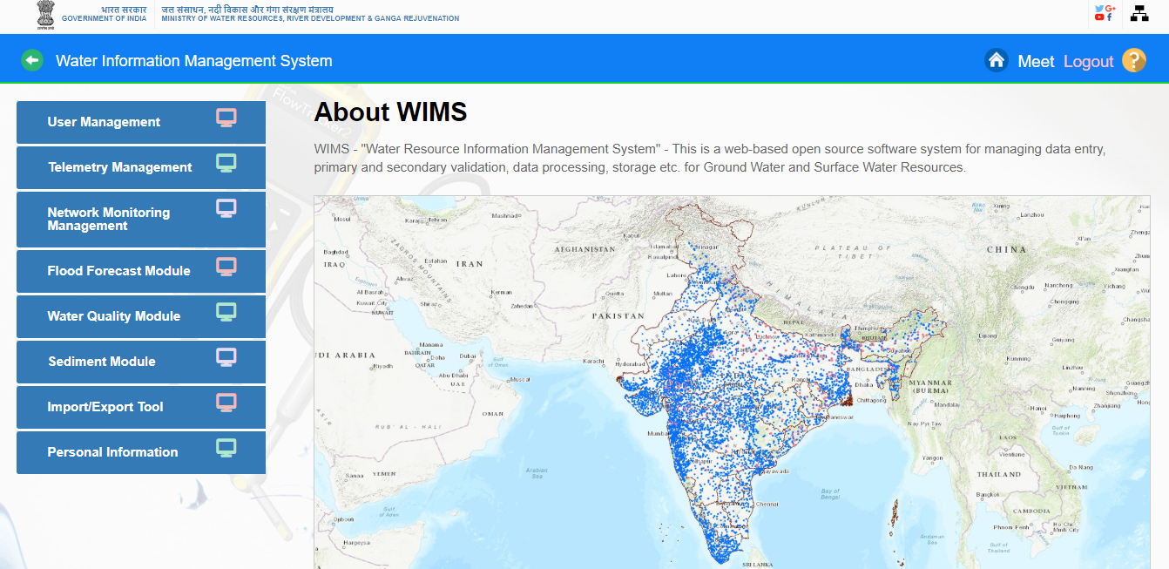
Home page of WIMS will be displayed on screen after login into WIMS application. User once done with the work can logout the session using the Logout Icon on the right top corner. Home Icon is to navigate back to the main page from sub modules page

Slide 8
TELEMETRY MANAGEMENT IN WIMS

Slide 9
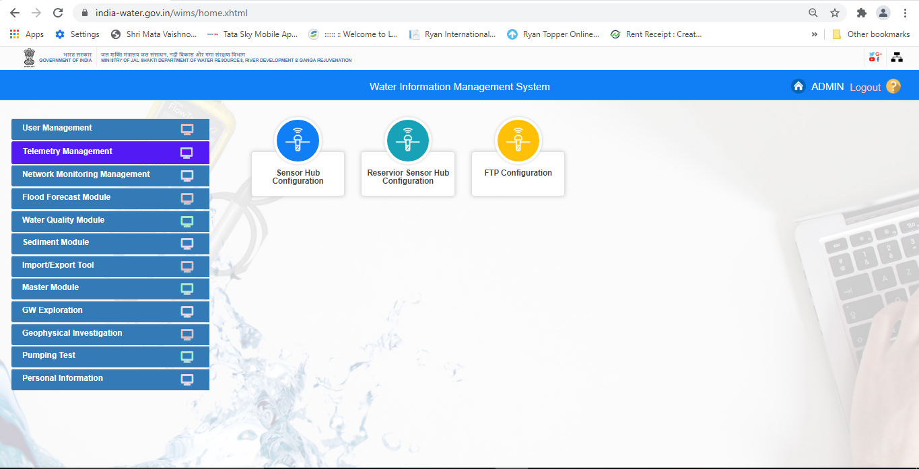
Telemetry Management for Surface Water and Ground Water Station Types in WIMS

Slide 10
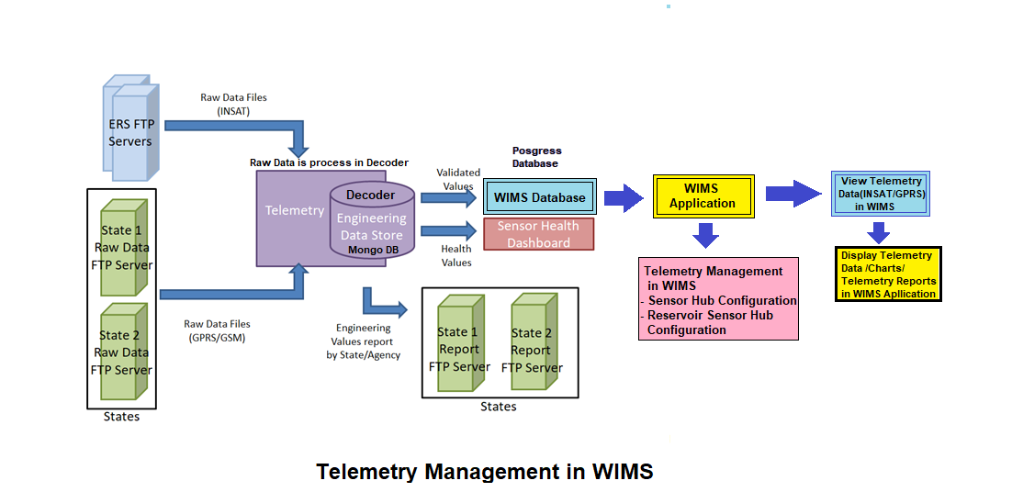
Telemetry Management (INSAT/GPRS) for both Surface Water and Ground Water in WIMS

Slide 11
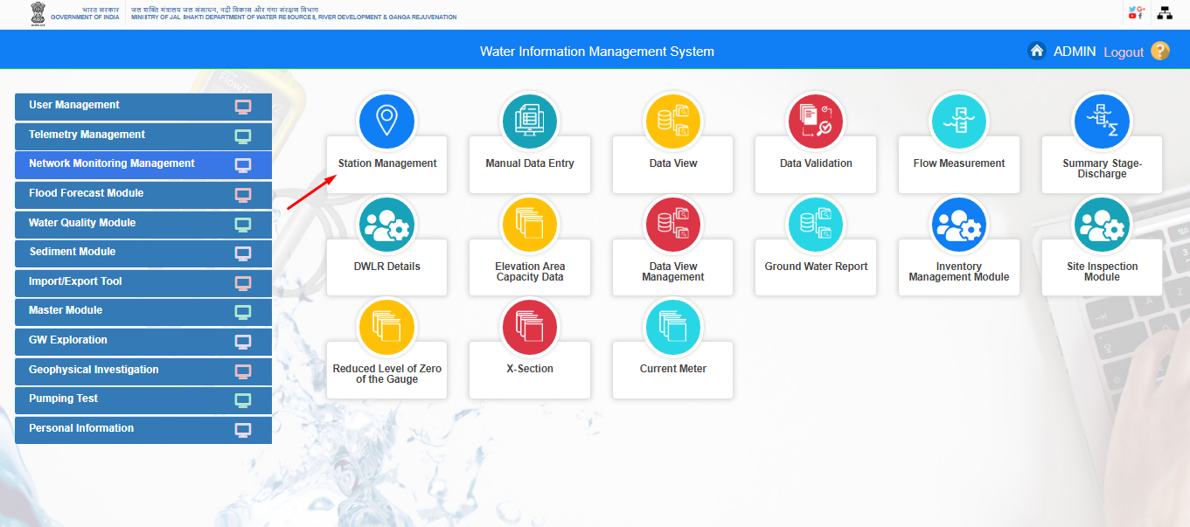
Add/Edit Telemetric Station (Surface Water /Ground Water Station Types) in WIMS

Slide 12
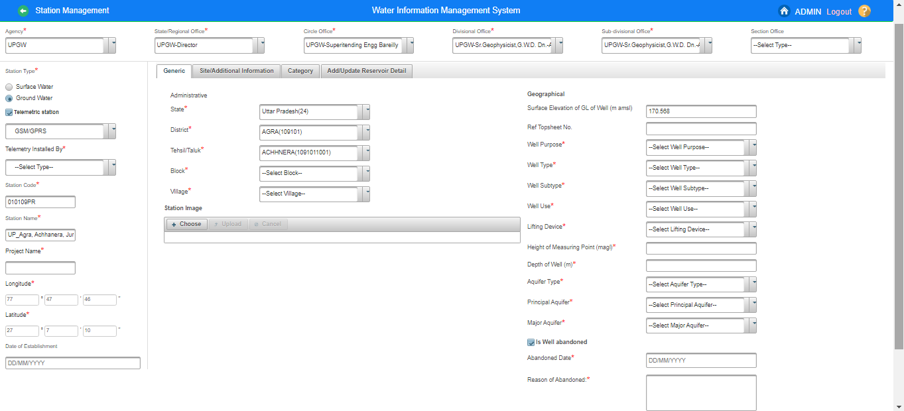
Add/ Edit Telemetric Station in WIMS For Ground Water Station Type

Slide 13
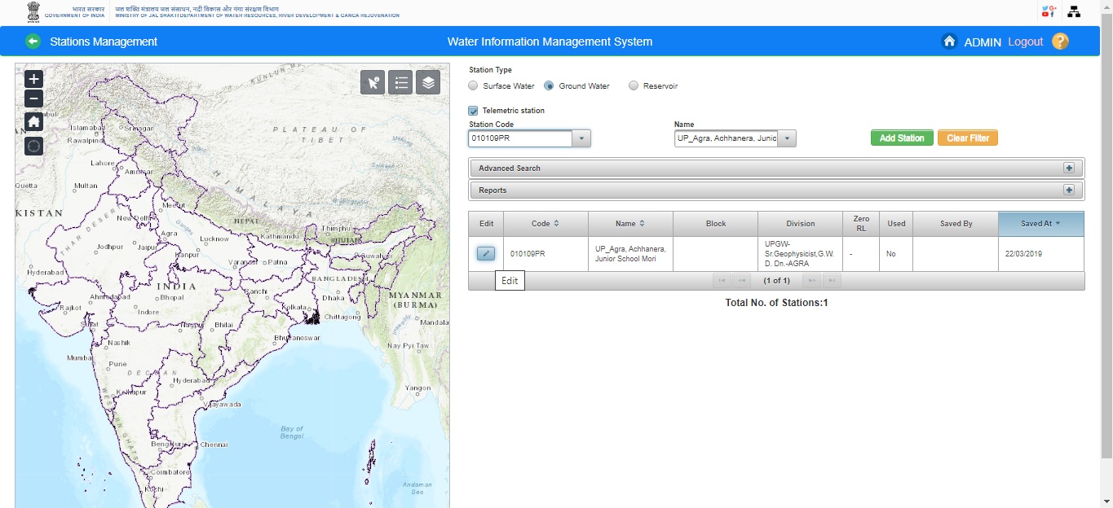
Add/ Edit Telemetric Station in WIMS For Ground Water

Slide 14
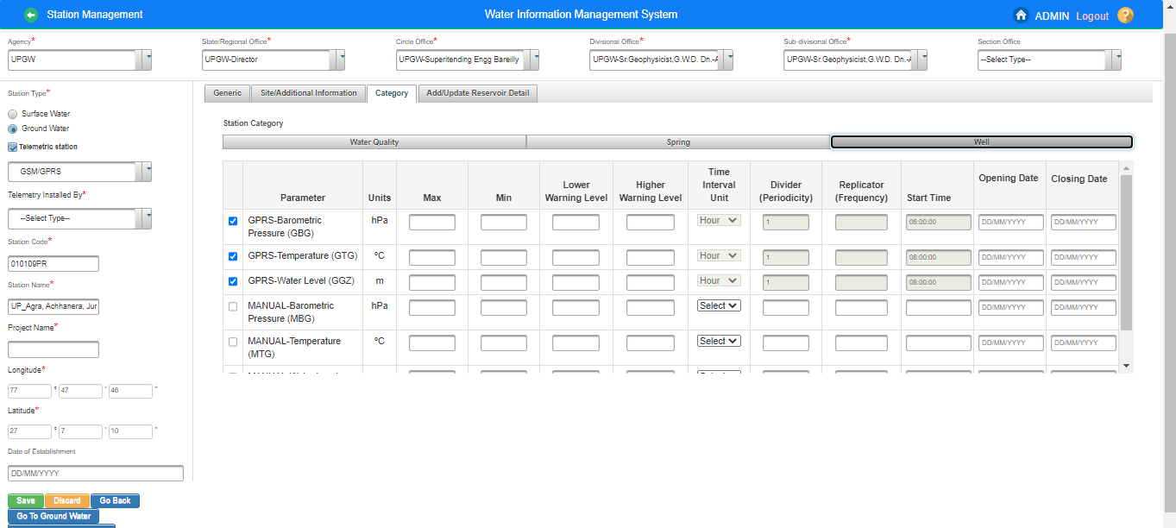
Sensor Mapping for Ground Water telemetric stations(DWLR) in WIMS

Slide 15
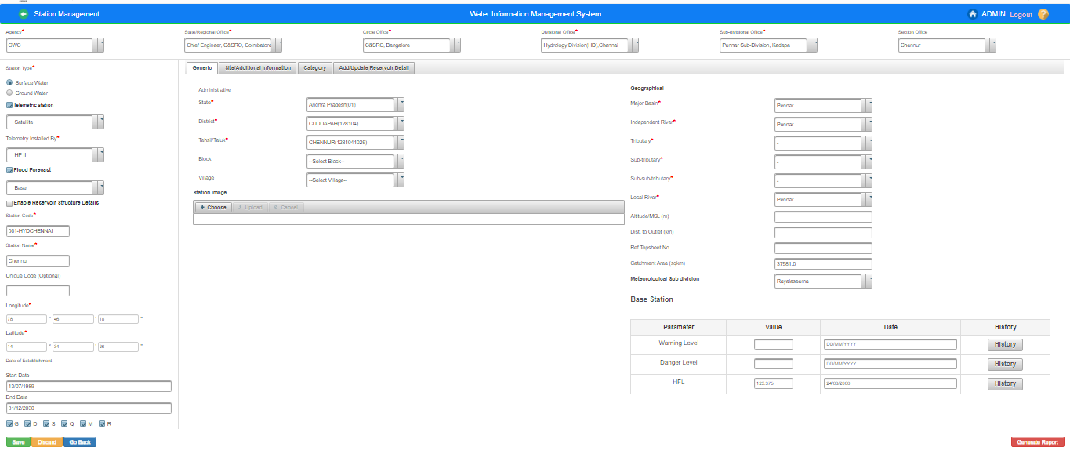
Add/Edit Telemetric Station in WIMS
For Surface Water Station Type

Slide 16
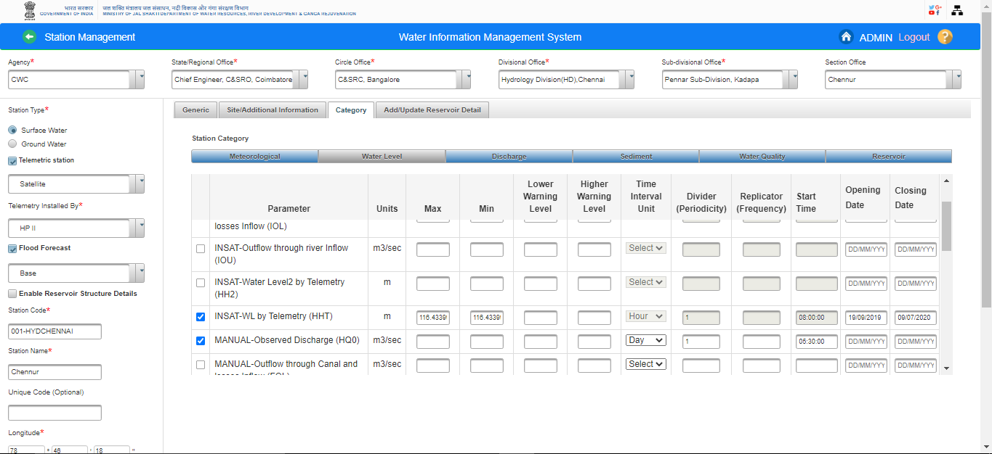
Sensors/ Data Type Mapping for Surface Water Telemetric Stations

Slide 17
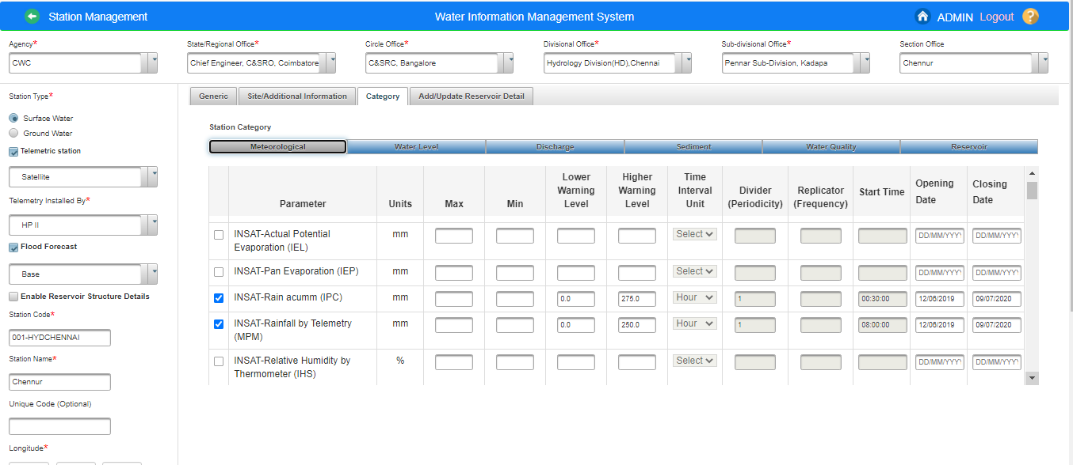

Slide 18
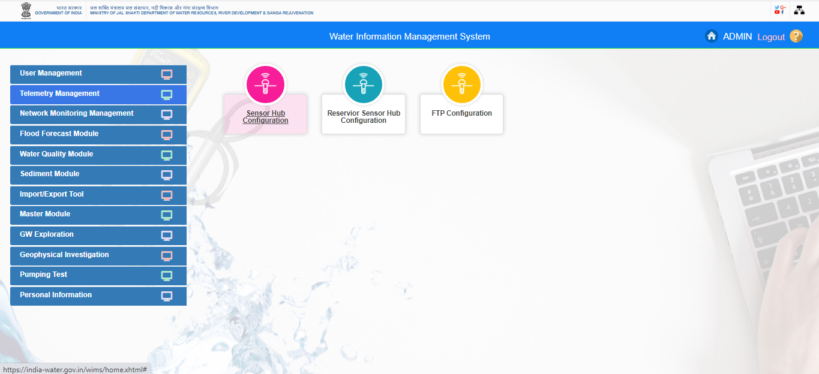

Slide 19
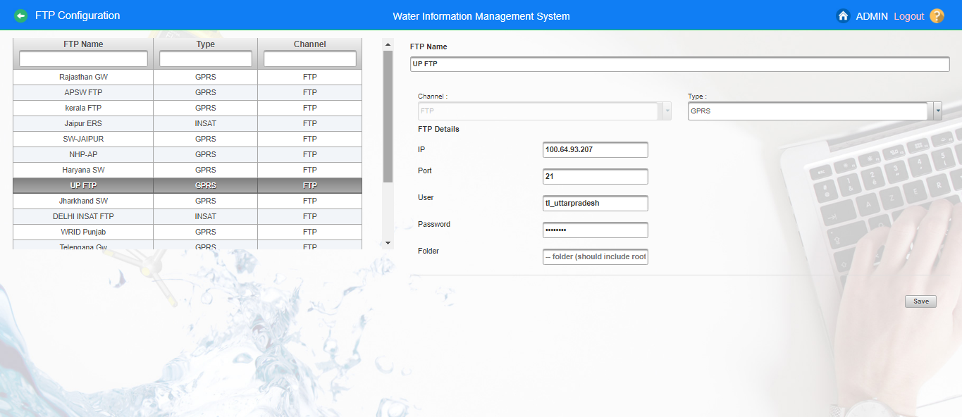
FTP Configuration for Ground Water Agencies

Slide 20
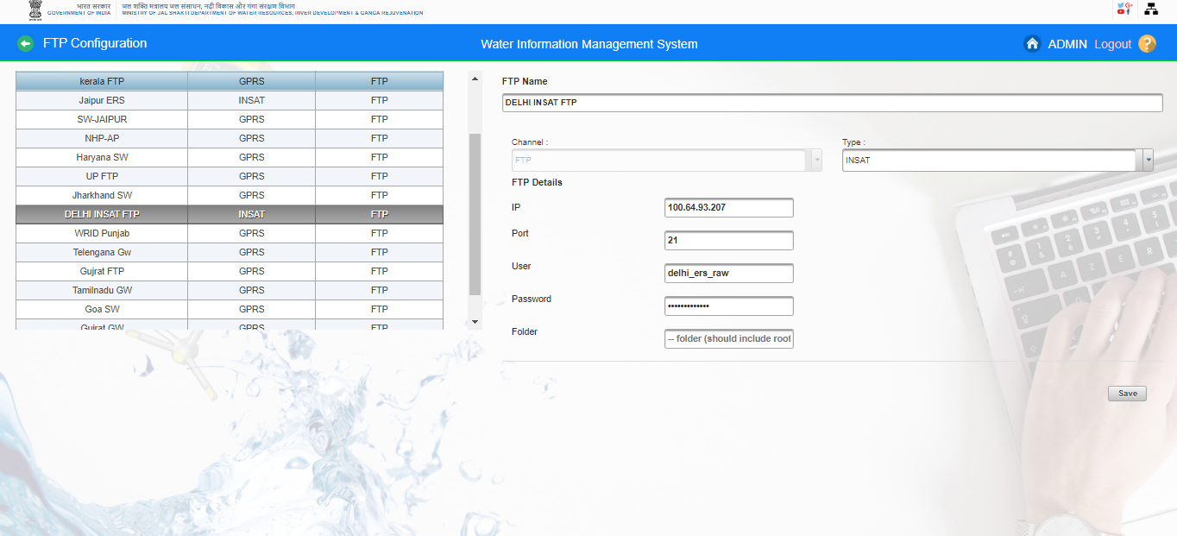
FTP Configuration for Surface Water Agencies

Slide 21
How to configure the sensors on telemetry sites in WIMS ? i) Create Data Logger Configuration ii) Add Sensor Configuration iii) Edit Sensor Configuration In Sensor Hub Configuration (Surface Water / Ground Water Station Types)

Slide 22
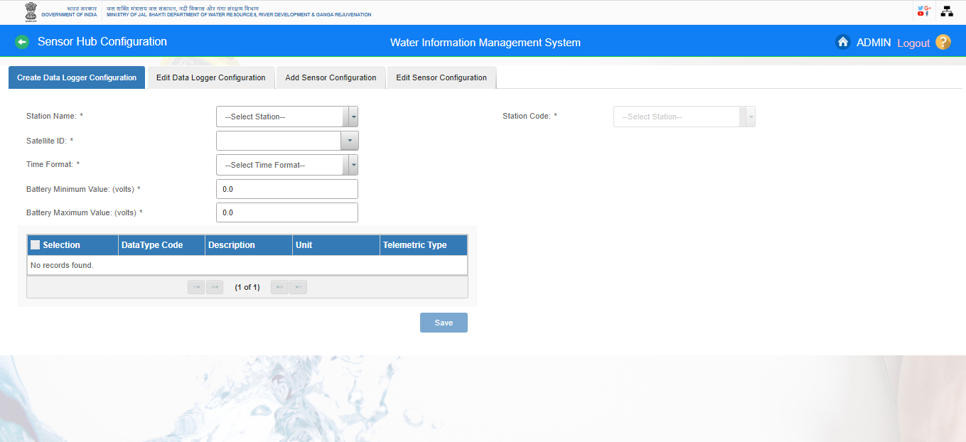
Sensor Hub Configuration for Ground Water & Surface Water Station Types-

Slide 23
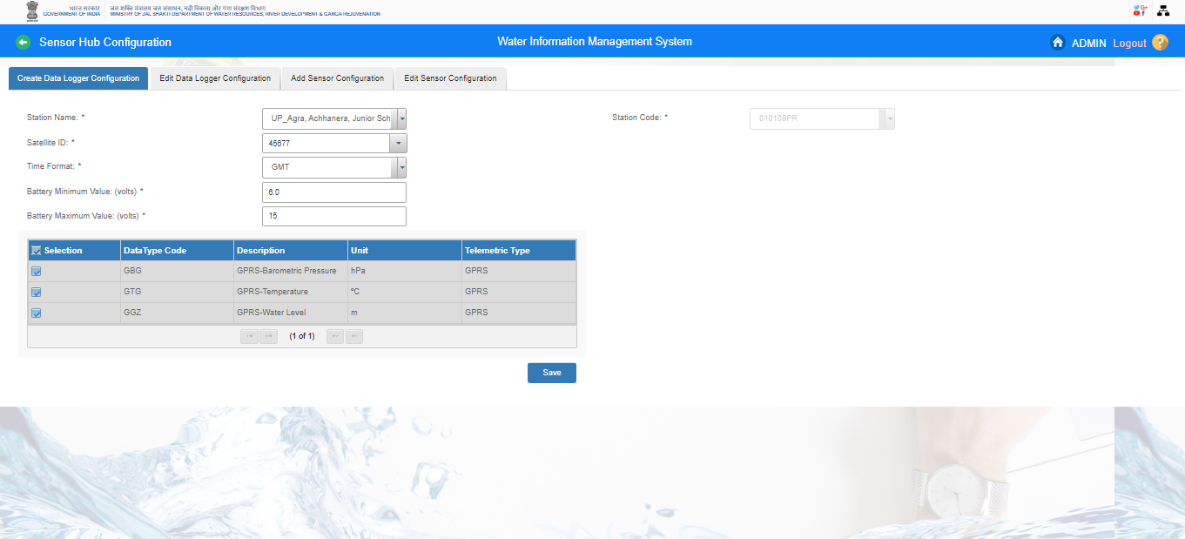
Create Data Logger Id for GW DWLR Stations

Slide 24
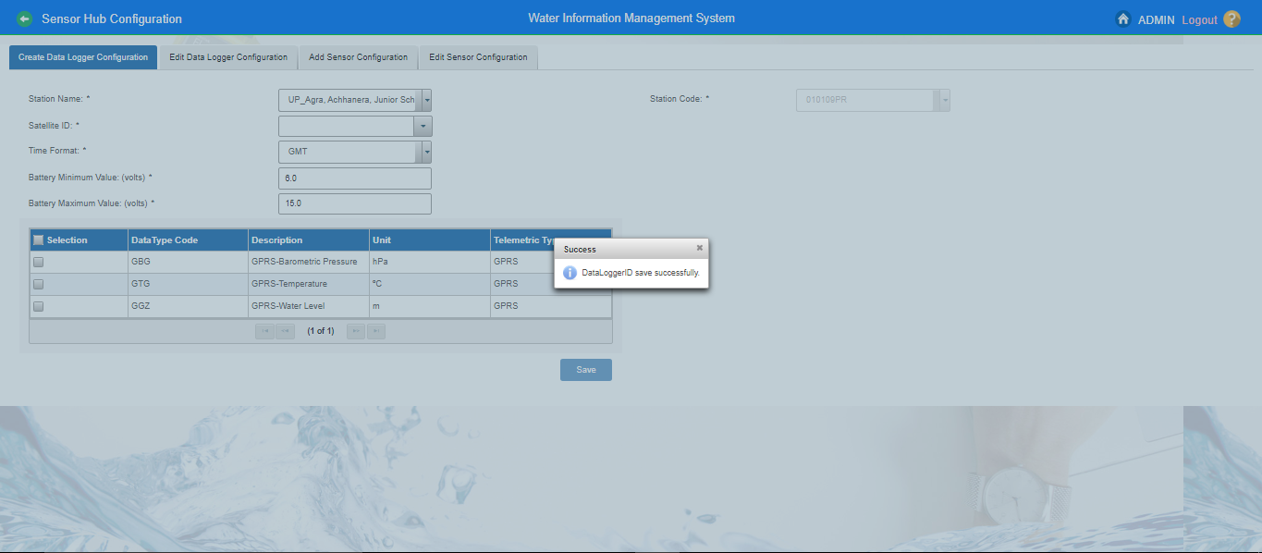
Create Data Logger Id for GW DWLR Stations

Slide 25
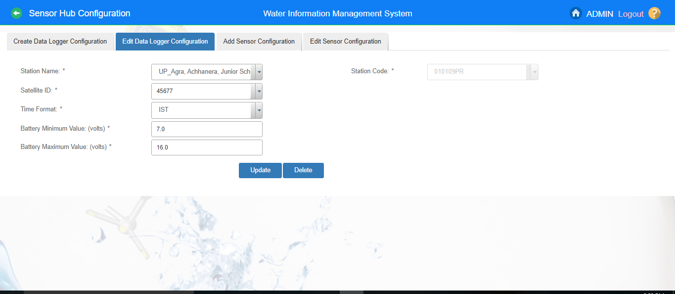
Edit Data Logger Id for GW DLWR Stations

Slide 26
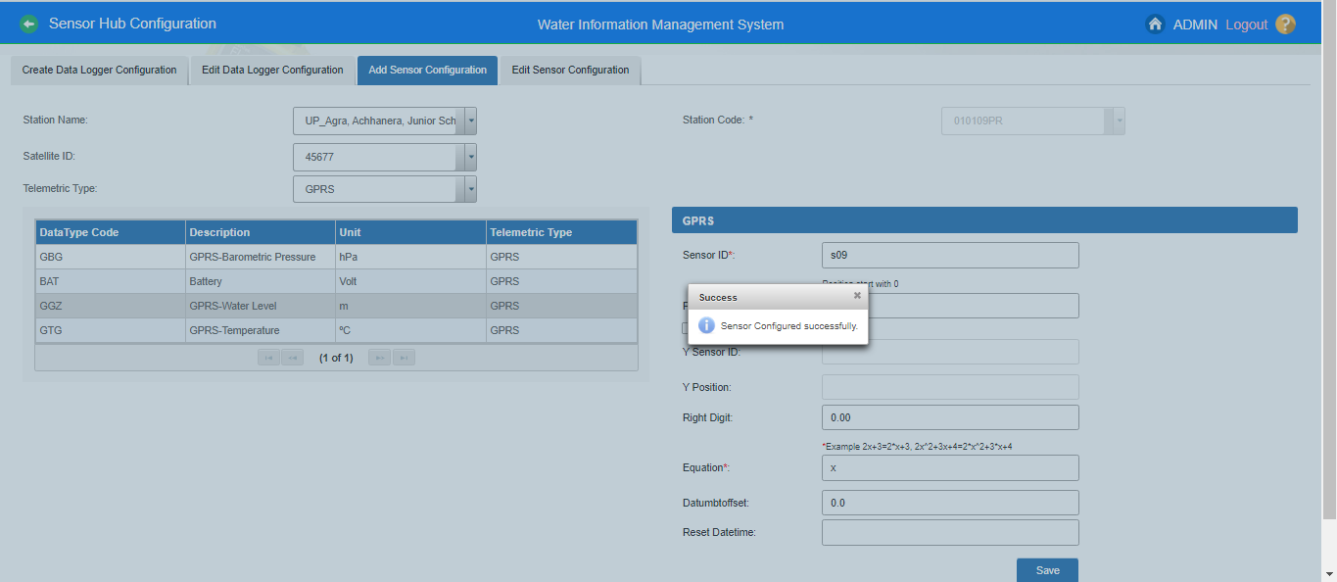
Add Sensor’s Configuration on GW DWLR telemetric Stations

Slide 27
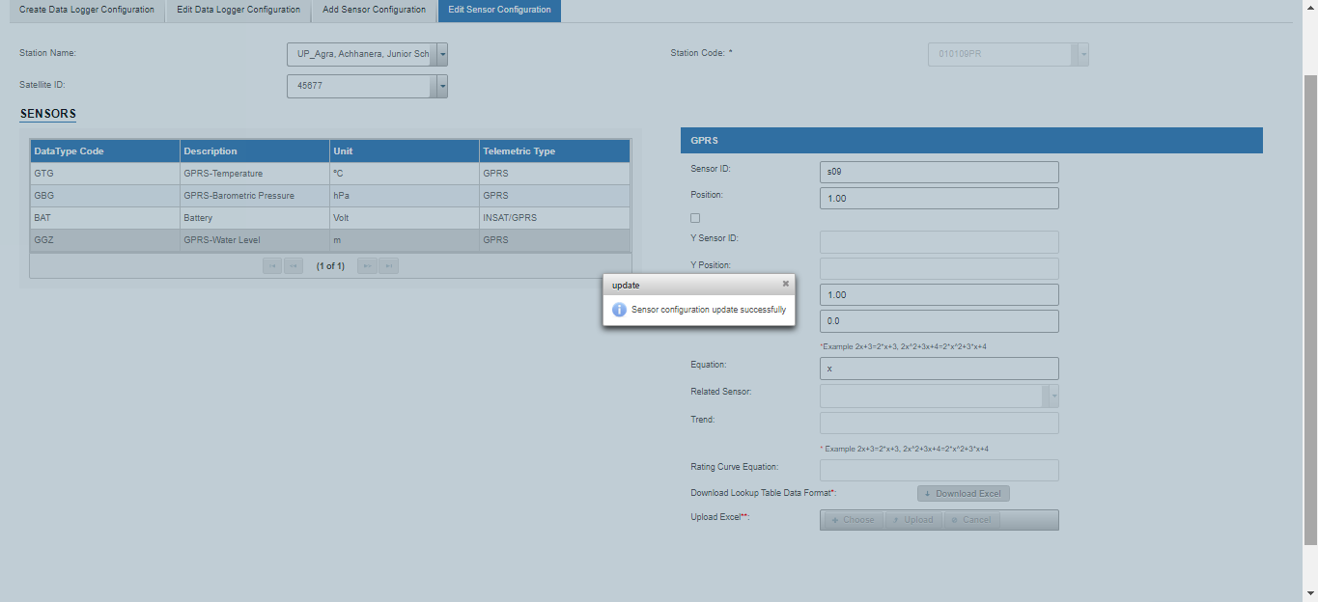
Edit Sensor’s Configuration on GW DWLR telemetric Stations

Slide 28
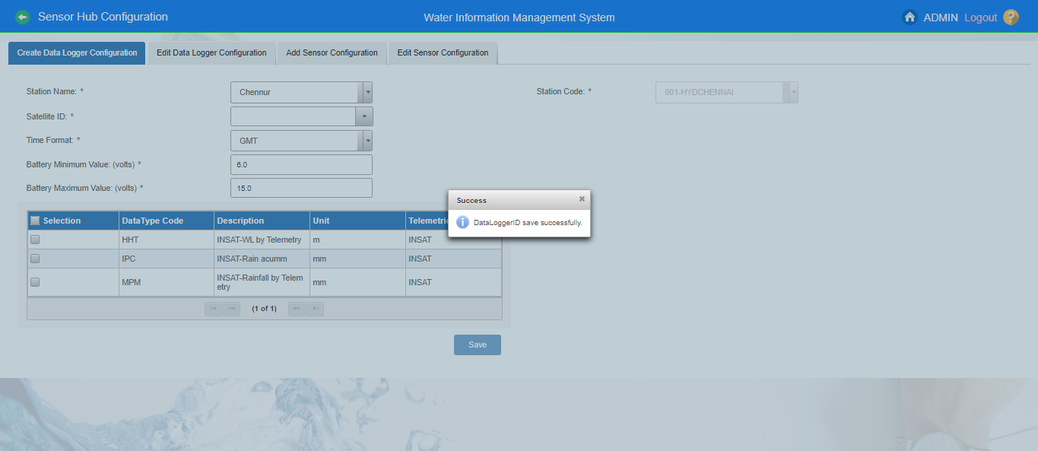
Create Data Logger Configuration for Surface Water Telemetric Station

Slide 29
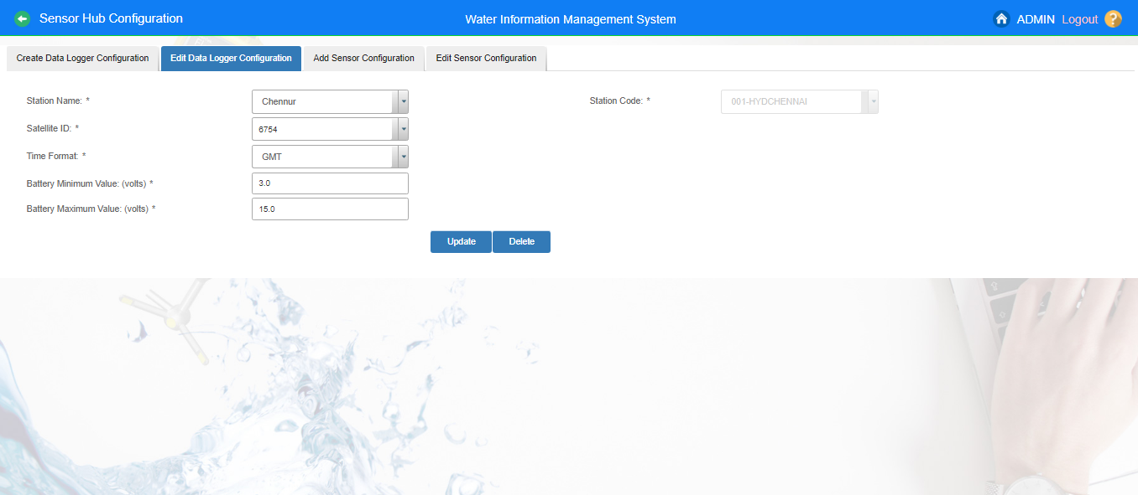
Edit Data Logger ID Configuration for Surface Water Telemetric Station

Slide 30
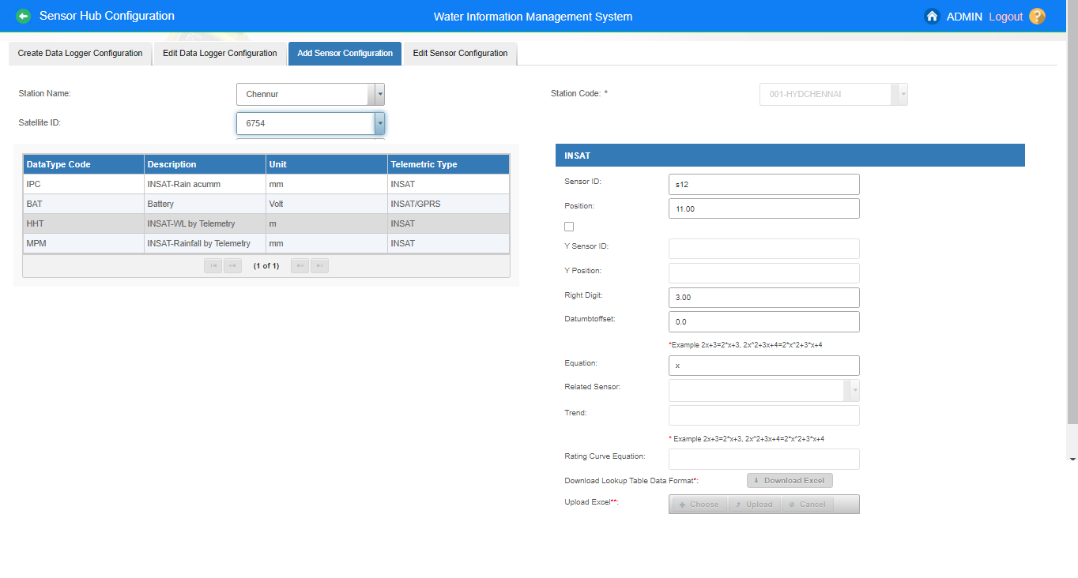
Add Sensor Configuration(Ex. HHT) for Surface Water Telemetric Station

Slide 31
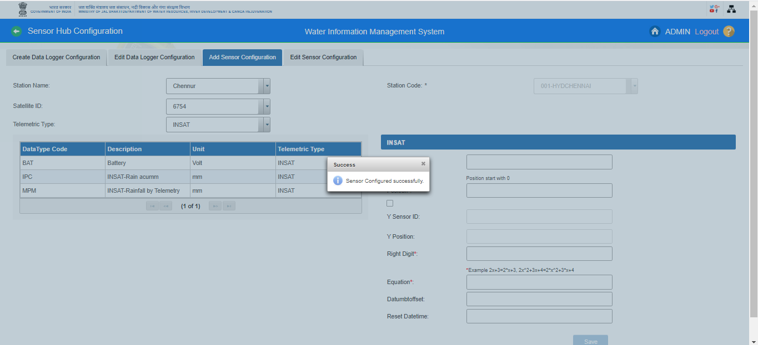
Add Sensor Configuration(Ex. HHT) for Surface Water Telemetric Station

Slide 32
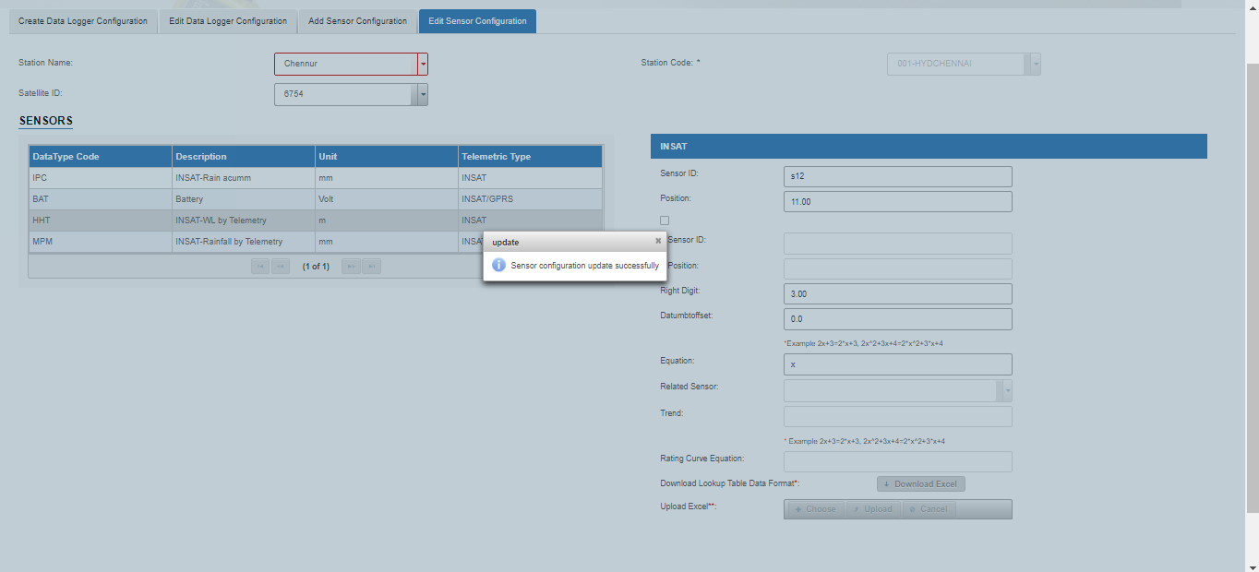
Edit Sensor Configuration for Surface Water Telemetric Stations

Slide 33
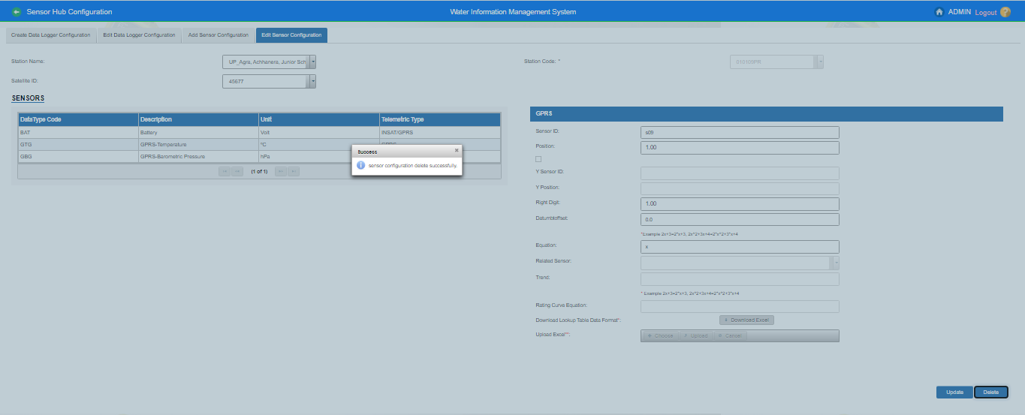
How to delete or remove the sensors from telemetric stations in WIMS? - Ground Water Station Type

Slide 34
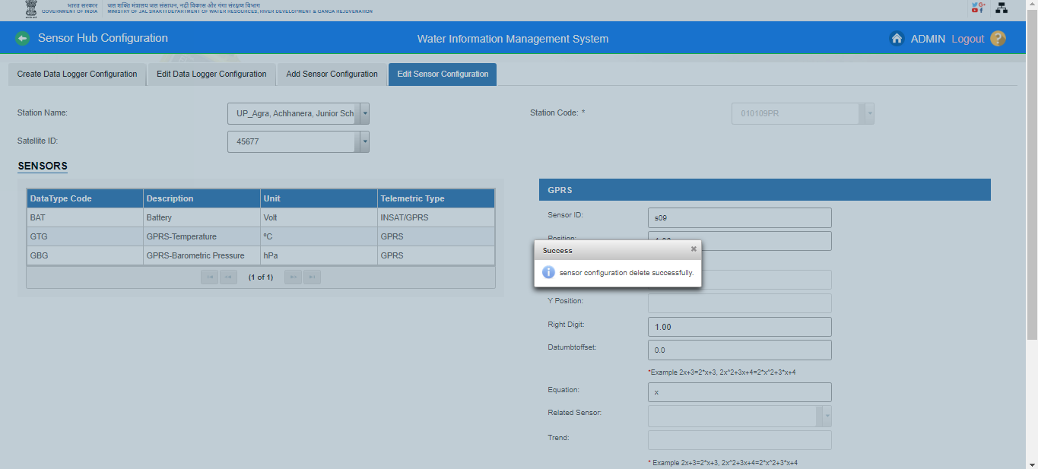

Slide 35
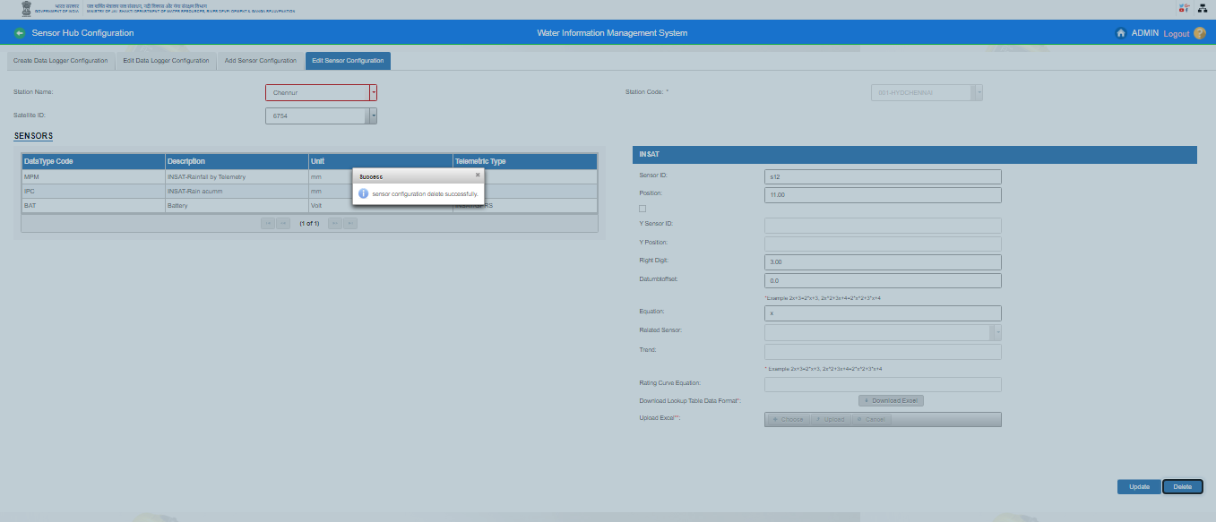
Delete the sensors from Surface Water Telemetric Stations

Slide 36
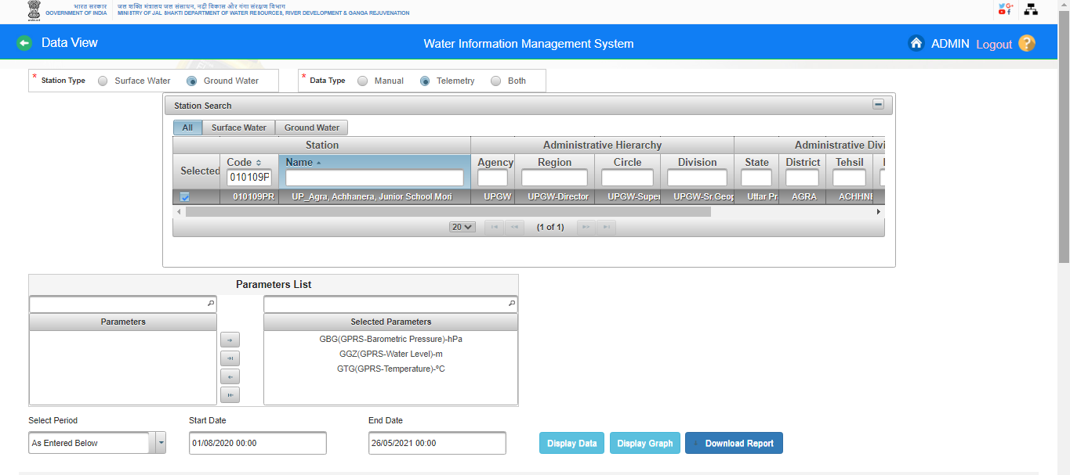
Data View – Surface Water/ Ground Water

Slide 37
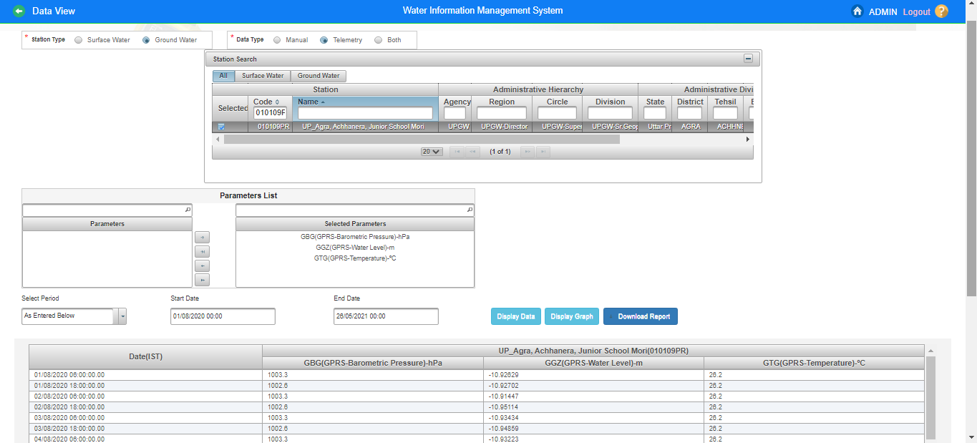
Data View – Ground Water

Slide 38
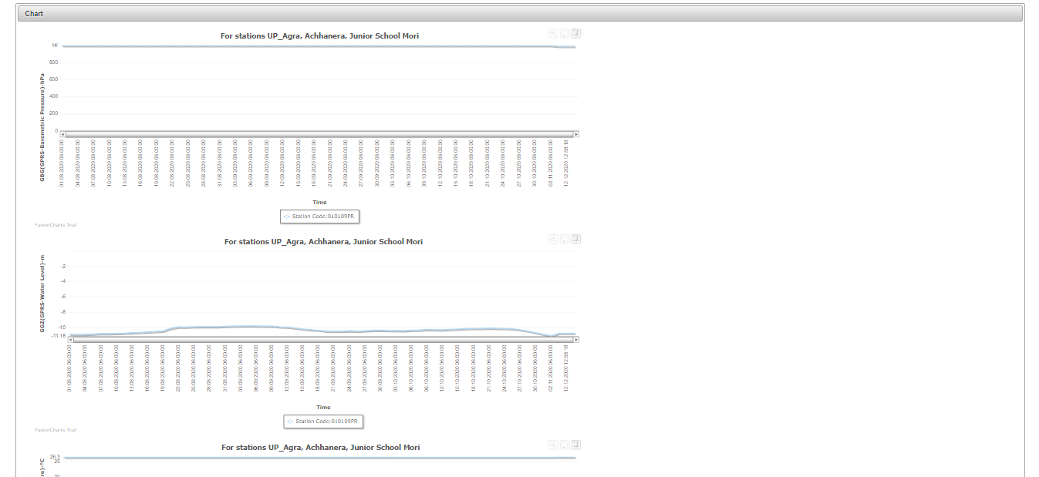
Data View (Ground Water)

Slide 39
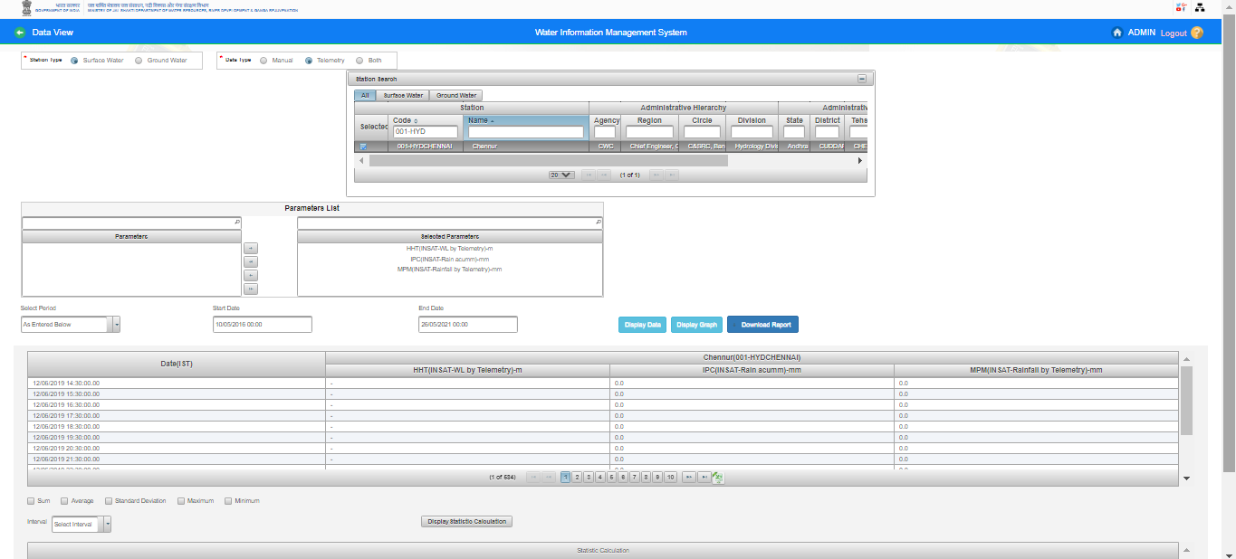
Data View – Surface Water

Slide 40
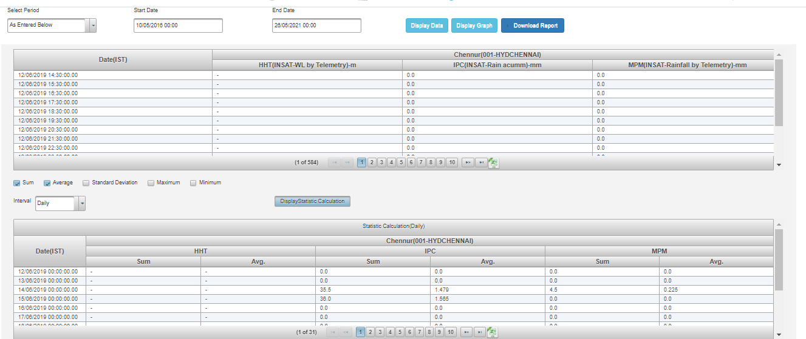
Data View

Slide 41
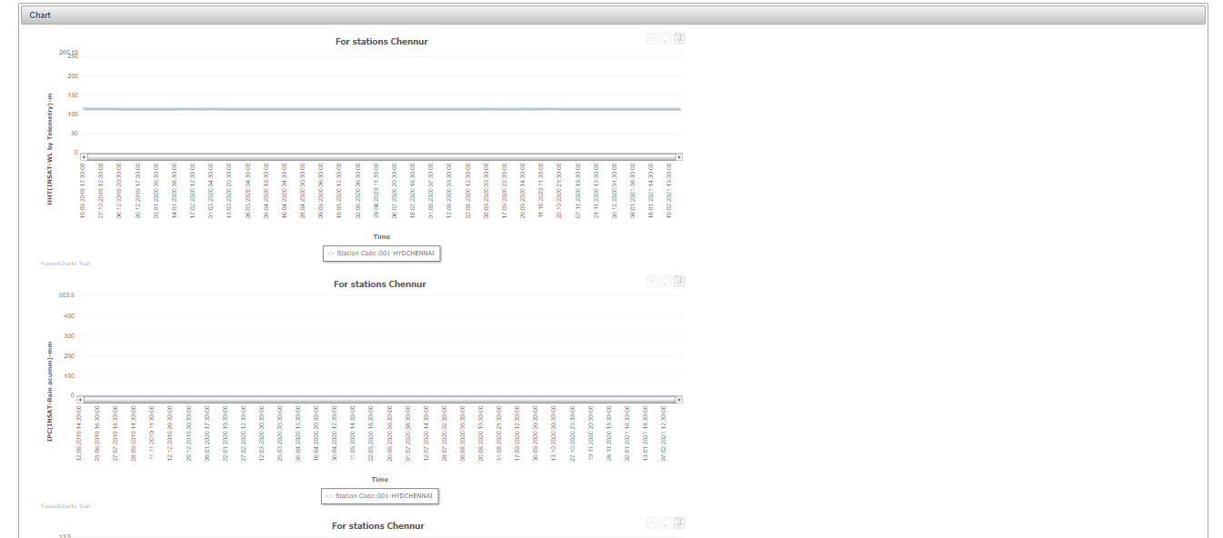
Data View

Slide 42
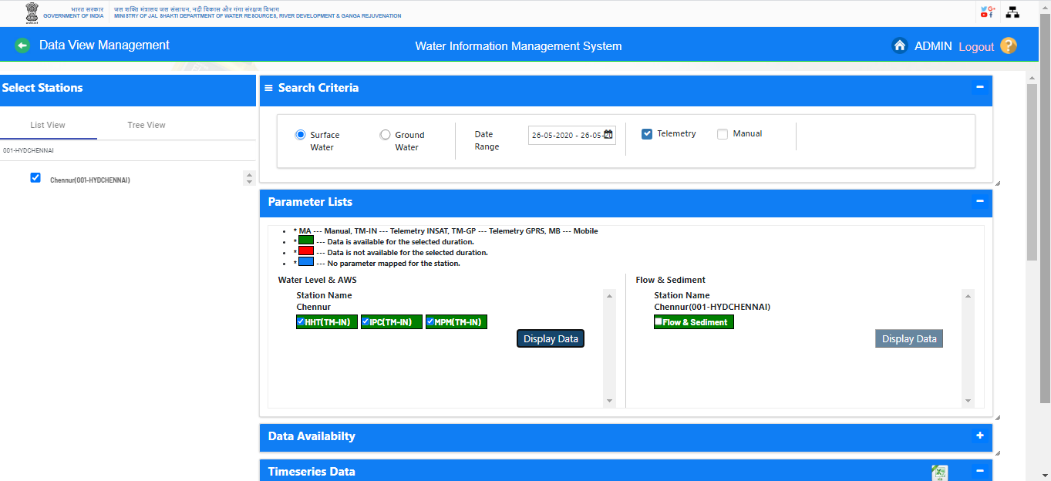
Data View Management (Surface Water/Ground Water)

Slide 43
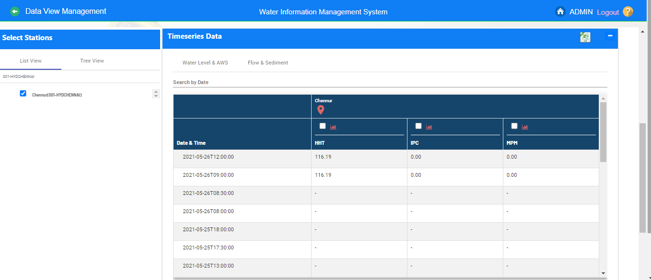
Data View Management (Surface Water Station Type)

Slide 44
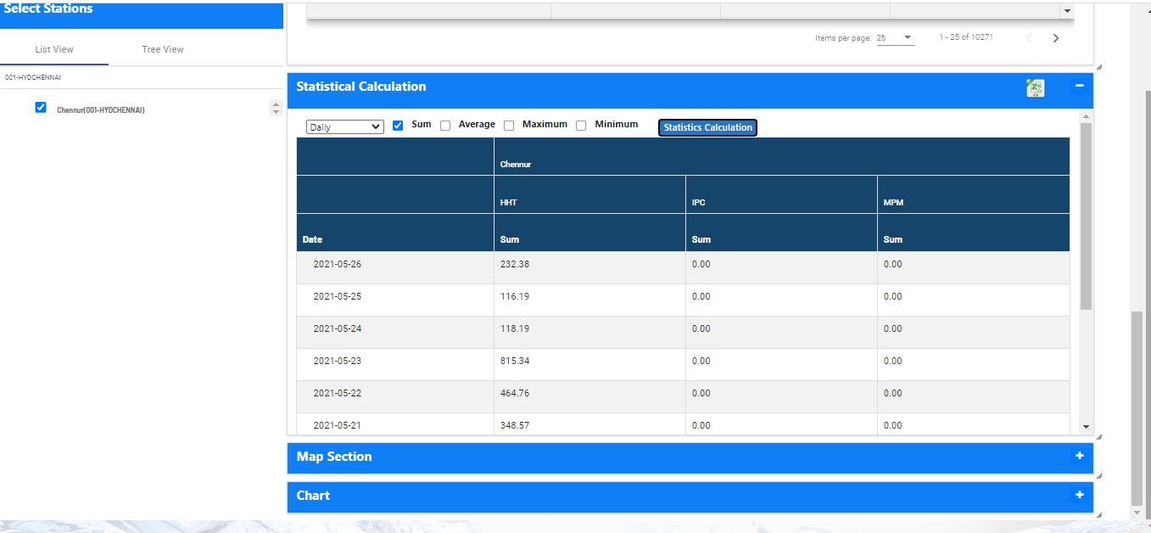
Data View Management (Surface Water Station Type)

Slide 45
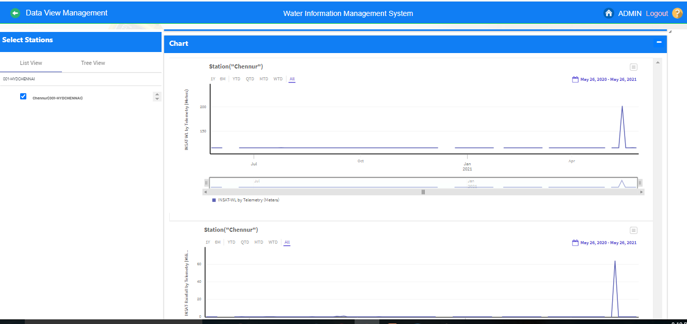
Data View Management (Surface Water Station Type)

Slide 46
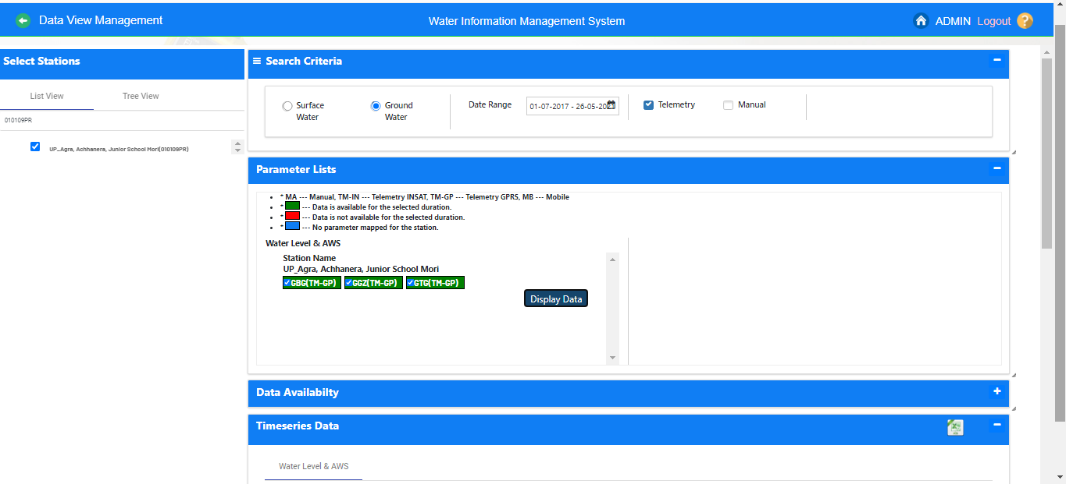
Data View Management (Ground Water Station Type)

Slide 47
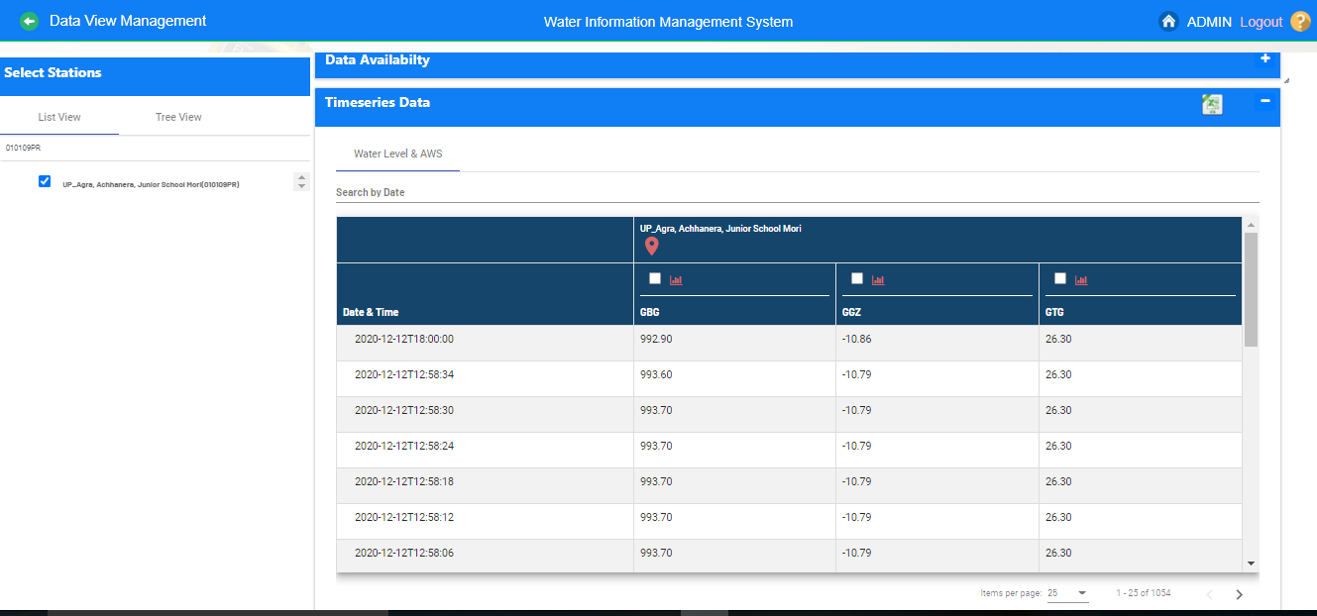
Data View Management (Ground Water Station Type)

Slide 48
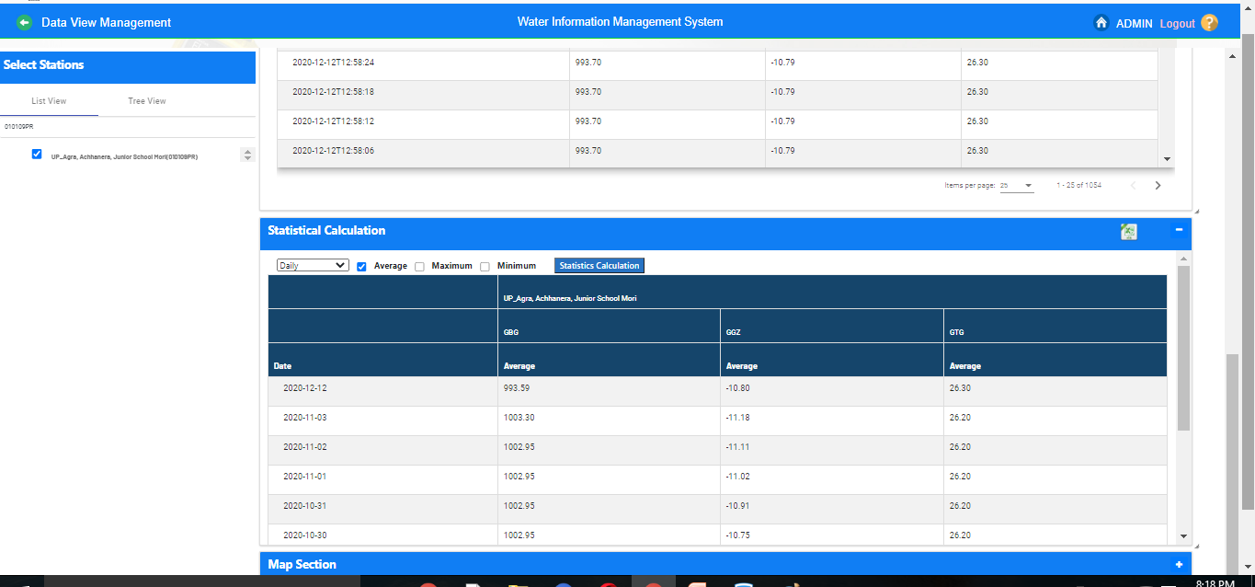
Data View Management (Ground Water Station Type)

Slide 49
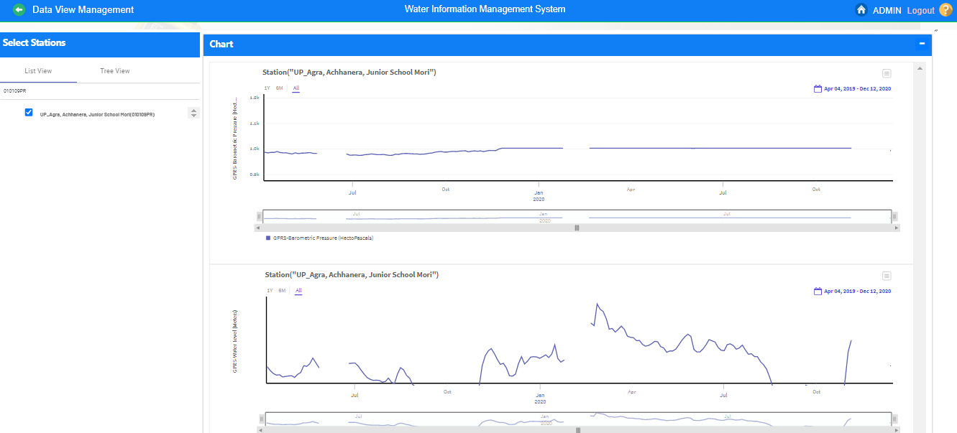
Data View Management (Ground Water Station Type)

Slide 50
Questions and Answers with Feedback
For any query & help, you can send email on helpdesk-nwic@gov.in

Slide 51
THANK YOU

